Slide 1

Project Title
Sensor Data Noise Reduction & Anomaly Detection System PROBLEM SYSTEM
DATA SCIENCE (24AD3107) Project Review-2
 | Under the Guidance of Ms.B.Prathusha Assistant Professor, Department of Computer Science and Engineering, KLH CSE Bowrampet Campus
Team Members 2420030657 -K.Akshitha 2420030703-G.Hemalatha 2420030735-G.V.S Hasini

Slide 2

Outline of Project Work
Focus
Introduction
Literature Survey
Challenges
Research Objectives
Conclusion & Future Work
References
Publications Details

Slide 3
Problem Statement
Our project focuses on patient health sensor data. Patient monitoring systems continuously collect readings such as body temperature, heart rate, blood pressure and oxygen level.
The main problem is that sensor data may contain noise, incorrect readings, missing values or sudden changes. In a normal environment, a small change in temperature may not be very important. But in patient monitoring, even a small incorrect reading can be important because it may give a wrong indication of the patient's health condition.
For example, if a sensor incorrectly records a patient's temperature or heart rate, it may appear that the patient's condition has changed when actually it is only sensor noise. Therefore, simply collecting the data is not enough. We need to make the data more reliable before analyzing it.
Our project addresses this problem by cleaning the patient sensor data, reducing unwanted noise using Moving Average and Kalman Filtering, and detecting unusual readings using anomaly detection. The cleaned and abnormal readings are then displayed through graphs or a dashboard.
The main aim is to make patient sensor data more reliable so that unusual changes can be identified more clearly and the data can support better analysis

Slide 4
Objectives
Collect patient sensor data such as temperature, heart rate, blood pressure and oxygen level.
Remove unwanted noise from patient sensor readings.
Handle missing and incorrect readings in the dataset.
Detect unusual or abnormal patient readings.
Differentiate actual changes from sensor noise as much as possible through filtering and analysis.
Compare raw and filtered data to see how data quality improves.
Visualize patient readings and anomalies using graphs/dashboard.
Provide cleaner and more reliable patient data for analysis.

Slide 5
Literature Survey
Authors | Title of the Paper | Methodology | Inferences | Limitation/Future work
H.Y.Teh et al. [1] | Sensor Data Quality: A Systematic Review, Journal of Big Data, 2020 | • Studied different types of sensor data errors. • Reviewed methods for detecting and correcting poor-quality sensor data. | • Sensor data can contain errors, missing values, noise and outliers. • Data quality is important for reliable IoT applications | • Sensor data can contain errors, missing values, noise and outliers. • Data quality is important for reliable IoT applications
A.Chatterjee and B. S. Ahmed [2] | IoT Anomaly Detection Methods and Applications: A Survey, 2022 | • Reviewed statistical, machine-learning and other anomaly detection methods. • Studied anomaly detection in sensor monitoring, smart homes and smart cities. Real-time monitoring is mentioned as future work. | • Anomaly detection is important for identifying unusual IoT sensor behavior. • Different techniques are suitable for different IoT applications. | • Challenges remain with multiple sensors, changing data patterns and limited ground-truth data. • More robust real-time methods are needed.
A. Goknil et al. [3] | A Systematic Review of Data Quality in CPS and IoT for Industry 4.0, 2023 | • Reviewed methods for improving data quality in IoT and cyber-physical systems. • Need for practical and automated data-quality monitoring. | • Sensor failures and uncertain conditions can reduce data quality. • Data quality is important for reliable decision-making. | • More practical and scalable data-quality solutions are required for industrial IoT. • Future work can improve automated quality monitoring.

Slide 6
Problem Gap Identification
Patient sensor data may contain noise, missing values, and incorrect readings.
It is difficult to identify whether a sudden change is a real patient condition or sensor noise.
Existing systems may focus mainly on collecting and displaying patient data.
Noise reduction and anomaly detection are often treated as separate processes.
There is a need for a system that can clean the data and detect abnormal readings together.
A clear comparison of raw data and filtered data can help users understand the improvement in data quality.
Even a small incorrect reading can be important when monitoring a patient's health.
Therefore, our project combines data preprocessing, noise reduction, anomaly detection, and visualization in one system.
The main gap is the lack of a simple integrated system that improves the quality of patient sensor data before detecting abnormal readings.

Slide 7
Innovation, Creativity, and Novelty
The proposed Patient Health Sensor Data Noise Reduction & Anomaly Detection System provides an integrated approach for improving the quality of patient sensor data. It combines noise reduction and anomaly detection to make patient health readings more reliable.
Innovation: Uses Moving Average and Kalman Filtering to reduce unwanted noise from patient sensor readings.
Creativity: Provides a visual dashboard to display raw patient data, filtered data, and detected abnormal readings using simple graphs.
Novelty: Combines data preprocessing, noise reduction, anomaly detection, and visualization in one platform.
The system helps identify whether a sudden change in a patient reading is an actual abnormal reading or possible sensor noise.
It focuses on patient parameters such as temperature, heart rate, blood pressure, and oxygen level.
The system can be extended in the future with real-time patient monitoring and machine-learning-based anomaly detection.

Slide 8
Feasibility
Technical Feasibility
Can be developed using Python, Pandas, NumPy, Matplotlib and Scikit-learn.
Moving Average and Kalman Filtering can be used for noise reduction.
Anomaly detection can be applied to identify unusual patient readings.
Dashboard can be used to visualize the results.
Economic Feasibility
Uses free and open-source software.
An existing patient dataset can be used.
No expensive hardware is required for the initial project.
Operational Feasibility
The system is simple to use.
Users can view patient readings, filtered data and abnormal readings through graphs.
The dashboard makes the results easier to understand.
Scalability
In future, the system can be connected to real-time patient monitoring sensors.
More health parameters and advanced machine-learning methods can be added.
The project is feasible because it uses easily available software, low-cost resources, simple processing techniques, and can be developed within the planned timeline.

Slide 9
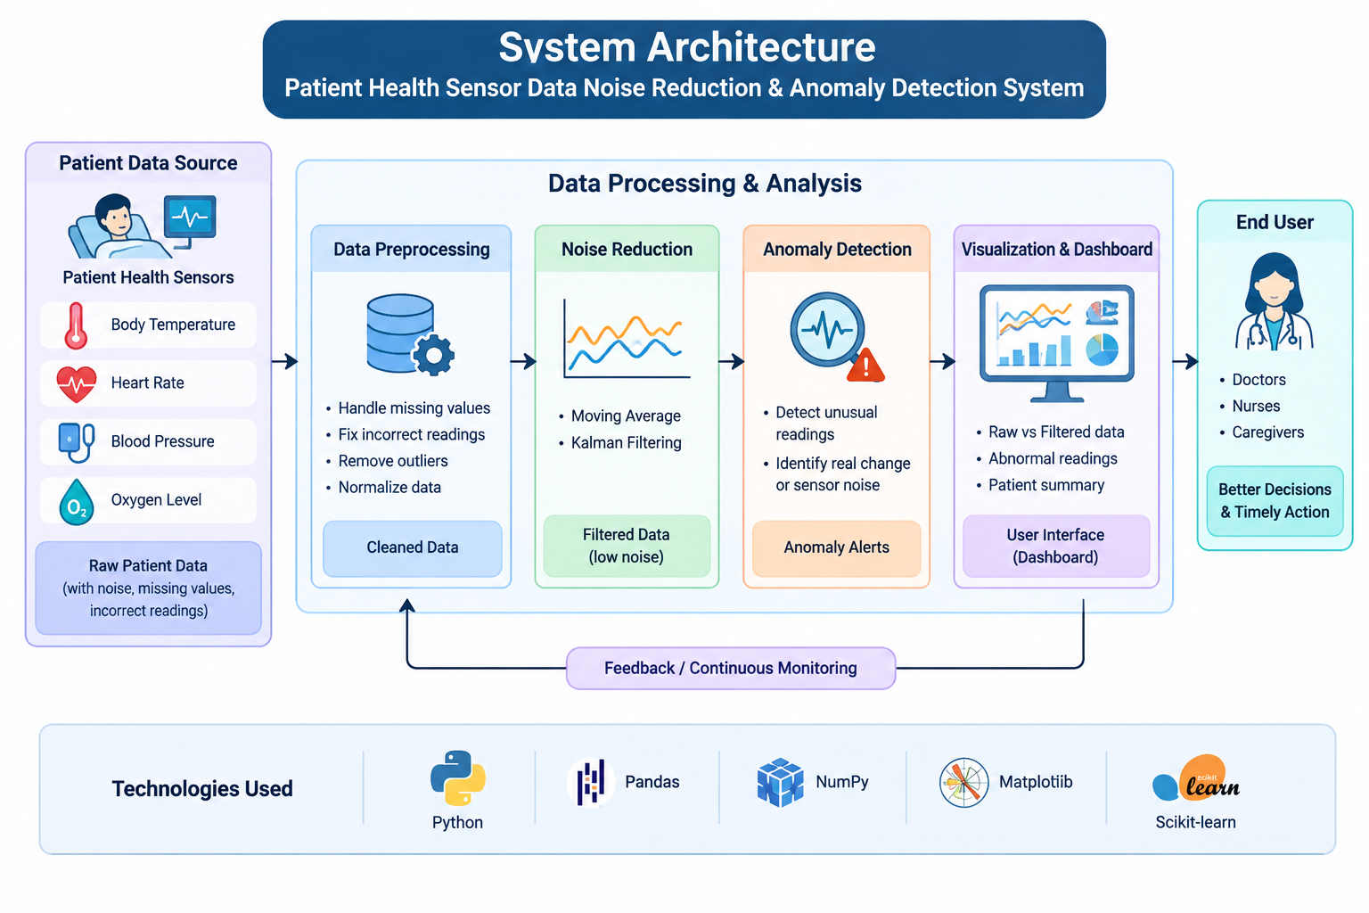

Slide 10
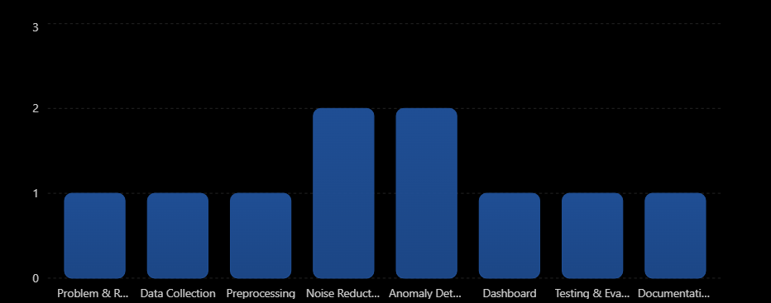
Project Plan
Phase | Activities | Timeline
Phase 1 | Problem identification and requirement analysis | Week 1
Phase 2 | Sensor dataset collection and understanding | Week 2
Phase 3 | Data preprocessing and handling missing values | Week 3
Phase 4 | Noise reduction using Moving Average and Kalman Filter | Weeks 4–5
Phase 5 | Anomaly detection and analysis | Weeks 6–7
Phase 6 | Dashboard and data visualization | Week 8
Phase 7 | Testing, evaluation, and comparison | Week 9
Phase 8 | Documentation, final report, and presentation | Week 10

